Slide 1

CS 389 – Software Engineering
Lecture 2 – Part 1
Chapter 2 – Software Processes
Adapted from:
Chap 1. Sommerville 9th ed.
Chap 1. Pressman 6th ed.

Slide 2
Topics covered
Software process models
Process activities
Coping with change
The Rational Unified Process
An example of a modern software process.

Slide 3
The software process
A structured set of activities required to develop a software system.
Many different software processes but all involve:
Specification – defining what the system should do;
Design and implementation – defining the organization of the system and implementing the system;
Validation – checking that it does what the customer wants;
Evolution – changing the system in response to changing customer needs.
A software process model is an abstract representation of a process. It presents a description of a process from some particular perspective.

Slide 4
Software process descriptions
When we describe and discuss processes, we usually talk about the activities in these processes such as specifying a data model, designing a user interface, etc. and the ordering of these activities.
Process descriptions may also include:
Products, which are the outcomes of a process activity;
Roles, which reflect the responsibilities of the people involved in the process;
Pre- and post-conditions, which are statements that are true before and after a process activity has been enacted or a product produced.

Slide 5
Plan-driven and agile processes
Plan-driven processes are processes where all of the process activities are planned in advance and progress is measured against this plan.
In agile processes, planning is incremental and it is easier to change the process to reflect changing customer requirements.
In practice, most practical processes include elements of both plan-driven and agile approaches.
There are no right or wrong software processes.

Slide 6
Software process models
The waterfall model
Plan-driven model. Separate and distinct phases of specification and development.
Incremental development
Specification, development and validation are interleaved. May be plan-driven or agile.
Reuse-oriented software engineering
The system is assembled from existing components. May be plan-driven or agile.
In practice, most large systems are developed using a process that incorporates elements from all of these models.

Slide 7
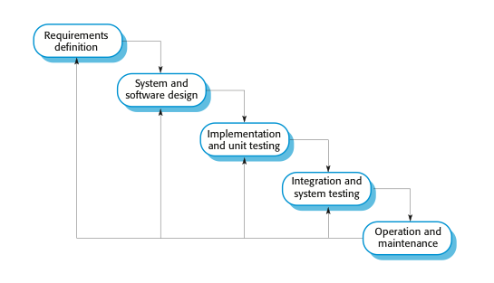
The waterfall model

Slide 8
Waterfall model phases
There are separate identified phases in the waterfall model:
Requirements analysis and definition
System and software design
Implementation and unit testing
Integration and system testing
Operation and maintenance
The main drawback of the waterfall model is the difficulty of accommodating change after the process is underway. In principle, a phase has to be complete before moving onto the next phase.

Slide 9
Waterfall model problems
Inflexible partitioning of the project into distinct stages makes it difficult to respond to changing customer requirements.
Therefore, this model is only appropriate when the requirements are well-understood and changes will be fairly limited during the design process.
Few business systems have stable requirements.
The waterfall model is mostly used for large systems engineering projects where a system is developed at several sites.
In those circumstances, the plan-driven nature of the waterfall model helps coordinate the work.

Slide 10
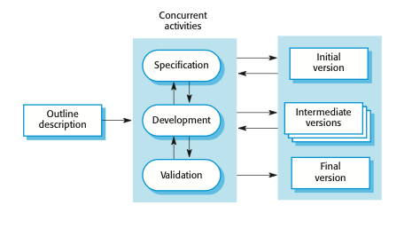
Incremental development

Slide 11
Incremental development benefits
The cost of accommodating changing customer requirements is reduced.
The amount of analysis and documentation that has to be redone is much less than is required with the waterfall model.
It is easier to get customer feedback on the development work that has been done.
Customers can comment on demonstrations of the software and see how much has been implemented.
More rapid delivery and deployment of useful software to the customer is possible.
Customers are able to use and gain value from the software earlier than is possible with a waterfall process.

Slide 12
Incremental development problems
The process is not visible.
Managers need regular deliverables to measure progress. If systems are developed quickly, it is not cost-effective to produce documents that reflect every version of the system.
System structure tends to degrade as new increments are added.
Unless time and money is spent on refactoring to improve the software, regular change tends to corrupt its structure. Incorporating further software changes becomes increasingly difficult and costly.

Slide 13
Reuse-oriented software engineering
Based on systematic reuse where systems are integrated from existing components or COTS (Commercial-off-the-shelf) systems.
Process stages
Component analysis;
Requirements modification;
System design with reuse;
Development and integration.
Reuse is now the standard approach for building many types of business system
Reuse covered in more depth in Chapter 16.

Slide 14
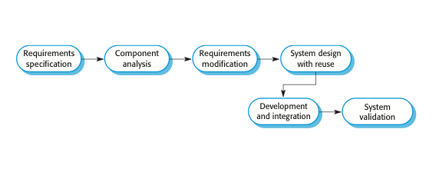
Reuse-oriented software engineering

Slide 15
Types of software component
Web services that are developed according to service standards and which are available for remote invocation.
Collections of objects that are developed as a package to be integrated with a component framework such as .NET or J2EE.
Stand-alone software systems (COTS) that are configured for use in a particular environment.

Slide 16
Process activities
Real software processes are inter-leaved sequences of technical, collaborative and managerial activities with the overall goal of specifying, designing, implementing and testing a software system.
The four basic process activities of specification, development, validation and evolution are organized differently in different development processes. In the waterfall model, they are organized in sequence, whereas in incremental development they are inter-leaved.

Slide 17
Software specification
The process of establishing what services are required and the constraints on the system’s operation and development.
Requirements engineering process
Feasibility study
Is it technically and financially feasible to build the system?
Requirements elicitation and analysis
What do the system stakeholders require or expect from the system?
Requirements specification
Defining the requirements in detail
Requirements validation
Checking the validity of the requirements

Slide 18
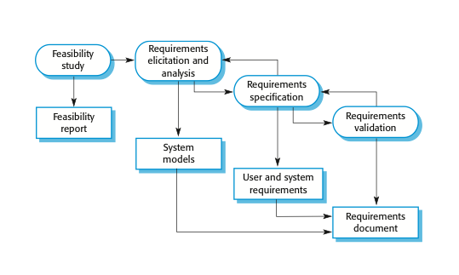
The requirements engineering process

Slide 19
Software design and implementation
The process of converting the system specification into an executable system.
Software design
Design a software structure that realises the specification;
Implementation
Translate this structure into an executable program;
The activities of design and implementation are closely related and may be inter-leaved.

Slide 20
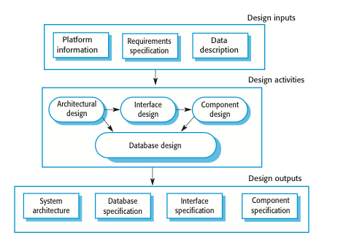
A general model of the design process

Slide 21
Design activities
Architectural design, where you identify the overall structure of the system, the principal components (sometimes called sub-systems or modules), their relationships and how they are distributed.
Interface design, where you define the interfaces between system components.
Component design, where you take each system component and design how it will operate.
Database design, where you design the system data structures and how these are to be represented in a database.

Slide 22
Software validation
Verification and validation (V & V) is intended to show that a system conforms to its specification and meets the requirements of the system customer.
Validation: The assurance that a product, service, or system meets the needs of the customer and other identified stakeholders. It often involves acceptance and suitability with external customers.
Verification: The evaluation of whether or not a product, service, or system complies with a regulation, requirement, specification, or imposed condition. It is often an internal process.
Involves checking and review processes and system testing.
System testing involves executing the system with test cases that are derived from the specification of the real data to be processed by the system.
Testing is the most commonly used V & V activity.

Slide 23
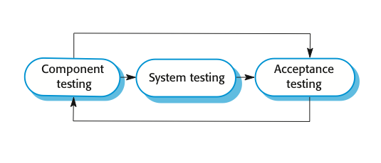
Stages of testing

Slide 24
Testing stages
Development or component testing
Individual components are tested independently;
Components may be functions or objects or coherent groupings of these entities.
System testing
Testing of the system as a whole. Testing of emergent properties is particularly important.
Acceptance testing
Testing with customer data to check that the system meets the customer’s needs.

Slide 25
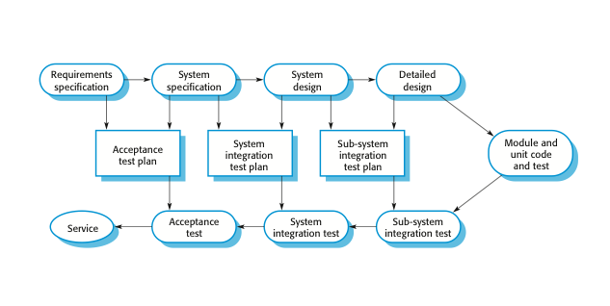
Testing phases in a plan-driven software process

Slide 26
Software evolution
Software is inherently flexible and can change.
As requirements change through changing business circumstances, the software that supports the business must also evolve and change.
Although there has been a demarcation between development and evolution (maintenance) this is increasingly irrelevant as fewer and fewer systems are completely new.

Slide 27
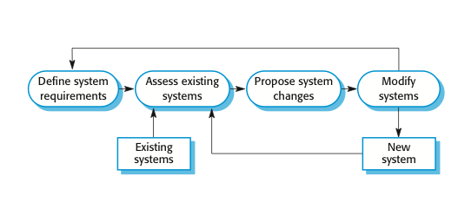
System evolution

Slide 28
Key points
Software processes are the activities involved in producing a software system.
Software process models are abstract representations of these processes.
General process models describe the organization of software processes.
Examples of these general models include the ‘waterfall’ model, incremental development, and reuse-oriented development.

Slide 29
Key points
Requirements engineering is the process of developing a software specification.
Design and implementation processes are concerned with transforming a requirements specification into an executable software system.
Software validation is the process of checking that the system conforms to its specification and that it meets the real needs of the users of the system.
Software evolution takes place when you change existing software systems to meet new requirements. The software must evolve to remain useful.

